Slide 1
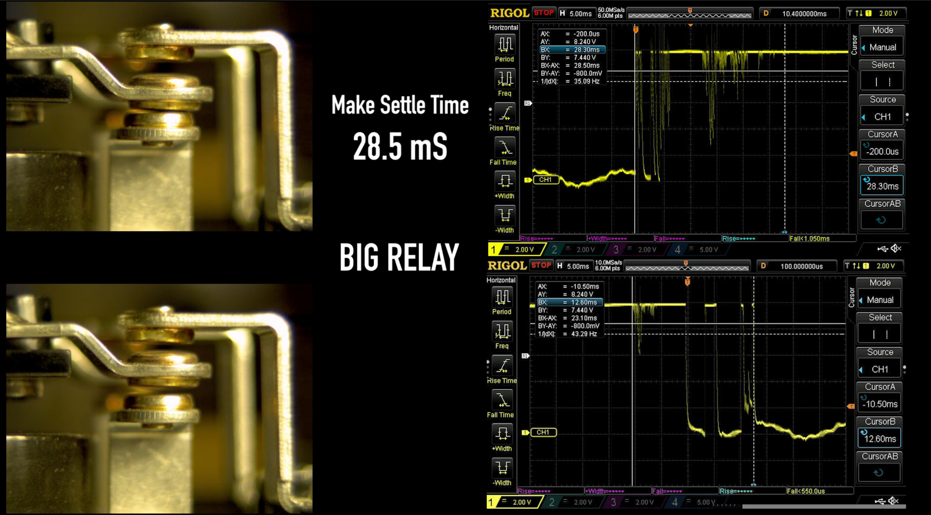

Slide 2
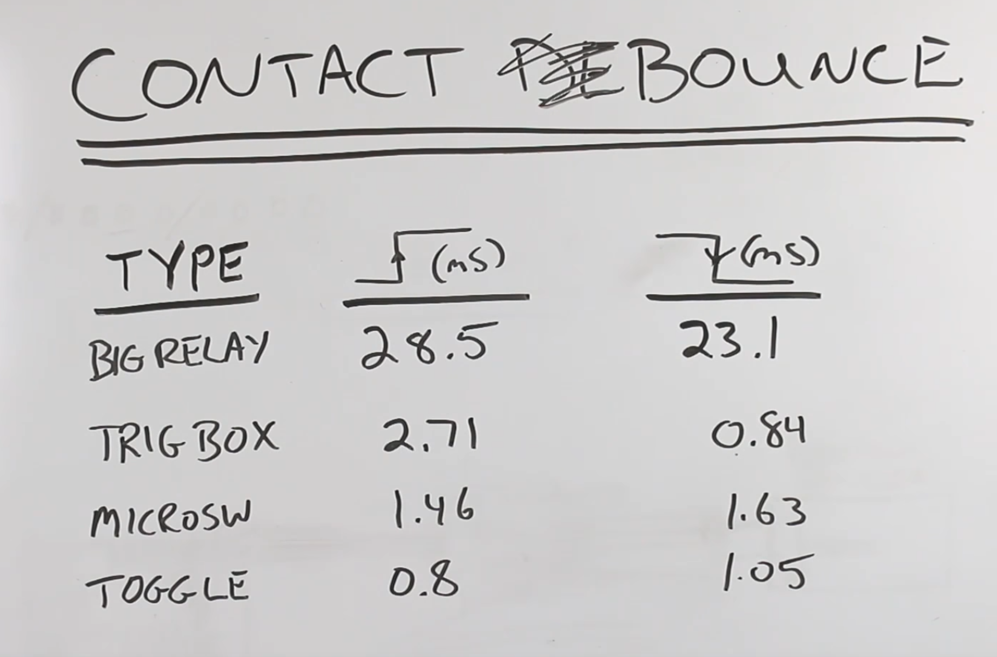
Switch Activated
Open to Close
Switch Deactivated
Close to Open
Notes:
https://youtu.be/jI-rC2FCKo4

Slide 3
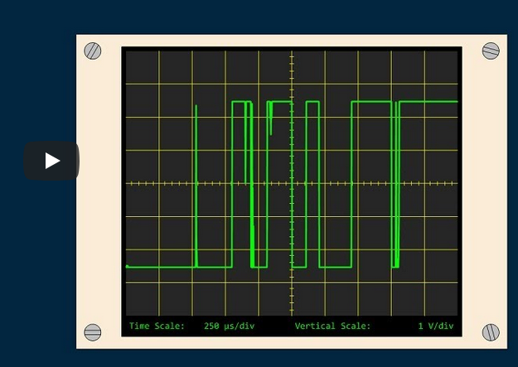

Slide 4
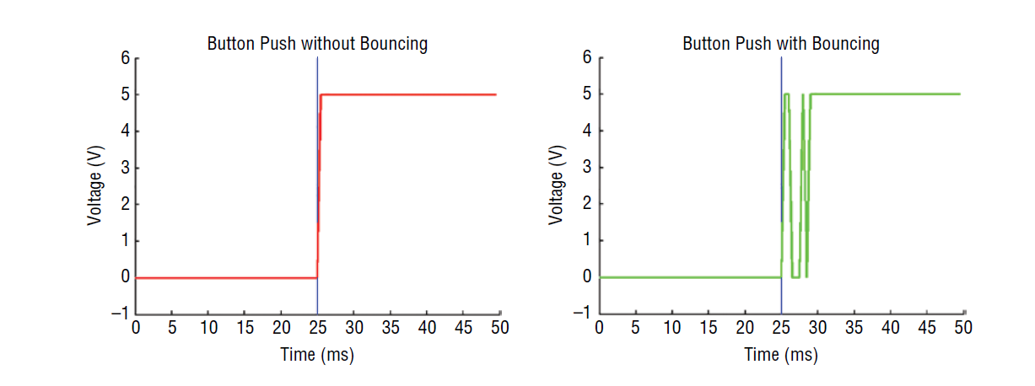
State Change Detected
State Change Check
Bouncing
Debouncing Window (12ms)
5 -
5 -
Steady High
2.5 -
Voltage (V)
2.5 -
Voltage (V)
Steady Low
0 -
0 -
0
5
10
15
20
25
30
35
40
45
50
0
5
10
15
20
25
30
35
40
45
50
Time (ms)
Time (ms)
35
40
45
50
55
60
65

Slide 5
Bouncing
Debouncing Window (12ms)
State Change Check
5 -
5 -
Steady High
State Change Detected
2.5 -
Voltage (V)
2.5 -
Voltage (V)
Steady Low
0 -
0 -
0
5
10
15
20
25
30
35
40
45
50
0
5
10
15
20
25
30
35
40
45
50
Time (ms)
Time (ms)
35
40
45
50
55
60
65

Slide 6
